Slide 1
Basic Concepts from Physics

Slide 2
To understand sound we need:
Ideas of force and motion, pressure, work and energy
Waves and kinds of waves
Mathematical description of waves and Wave Speed

Slide 3
Force
Forces can be understood by noting what we need to do to:
Change the motion of an object
Change the shape of an object
Change the position of an object
Forces are most basically understood through Newton’s 3 Laws
An object remains at rest or in constant motion unless acted upon by a force
F = ma
Forces always occur in equal and opposite pairs between bodies
This quantifies force

Slide 4
Simple examples
You have mass of 70 kg and a force causes you to speed up at a steady rate of (3 m/s)/s or 3 m/s²
Weight is the gravitational force on a body defined by

Slide 5
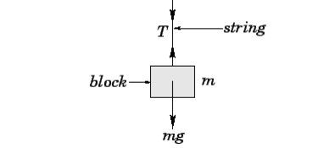
Elastic Forces
Springs exert forces when you try to deform or stretch/compress them
Tension forces are the forces exerted by strings, springs etc
Tension force in piano string is from 700 – 900 N. Total force on a grand piano frame is 155 000 N!
Tension force on A-string in violin varies between 50 – 60 N

Slide 6
Pressure
Pressure is Force acting over an area
Pressure is measured in Pascals (1 Pa = 1 N/m²)
Pressure on the classroom window is about 200 000 N on each side! How many “grand pianos” is this?

Slide 7
Work and Energy
We do work when we apply a force over a distance
The displacement must be in the same direction as the force
Simplest definition is
Work is measured in units of Joules or J
Work done changes energy of a body
Energy can be stored (potential energy), due to motion of atoms/molecules (thermal energy) or to motion in general (kinetic energy)
When there are no dissipative forces present (friction for example) then Energy is conserved. This means that energy can be transformed back and forth between energy of motion and stored (potential) energy

Slide 8
Vibration and Wave Motion
Vibration happens in a system when motion (deflection, stretching or compressing etc) creates a restoring force
Vibration propagates as a wave through an elastic medium
Wave motion represents a transfer of energy – waves “carry” energy
Sound waves are a vibration that propagates through the air

Slide 9
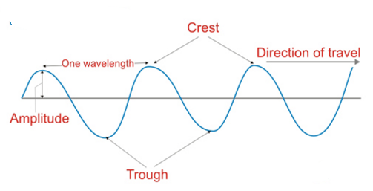
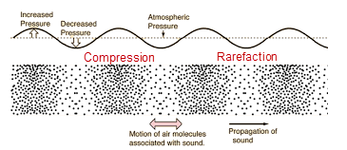
Wave Types
Vibration is perpendicular to the direction of wave motion – Transverse Wave Vibration in same direction as wave motion – Longitudinal Wave

Slide 10
The Wave Equation
V = wave speed
f = frequency (Hz)
λ= wavelength

